Slide 1
CZ4041 Machine Learning
Group 28
Jeremy Book Kay Yip
Hussain Khozema Kheriwala
Wong Ying
Lim Yu Jie
U1822479G
U1822071C
U1821686A
U1822070A
Kaggle: Plant Seedlings Classification
Notes:
https://www.youtube.com/watch?v=oY1Ii84T_w0&ab_channel=YixingChin
Hi everyone, this is group 28 and we would be presenting on our group assignment. We have chosen a kaggle competition, plant seedling classification.

Slide 2
Overview
1
2
Introduction
Data Preparation
3
4
Experiments
Conclusion
Notes:
This is the overview of this presentation.
In the introduction, we will discuss the problem statement and introduce the dataset.
For data preparation, we will walk you through the steps we have taken and discuss on feature engineering
We will go through a total of 14 experiments done and conclude with our results, the solution novelty and lesson learnt.

Slide 3

INTRODUCTION
Explore the potential of using machine learning to develop an image classification model to determine a plant's species from a photo
Problem
Statement
Notes:
Our problem statement is to explore the potential of using machine learning to develop an image classification model to determine a plant's species from a photo

Slide 4
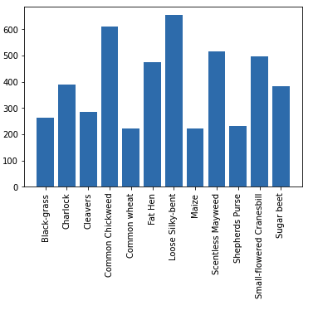
Dataset
INTRODUCTION
Plant Seedling Dataset
12 unique species of plants at various growth stages
4750 training images and 794 test images
Notes:
For this project, we will be using the plant seedling dataset. In this dataset, there are images of 12 unique species of plants at various growth stage, with 4750 training images and 794 test images.

Slide 5
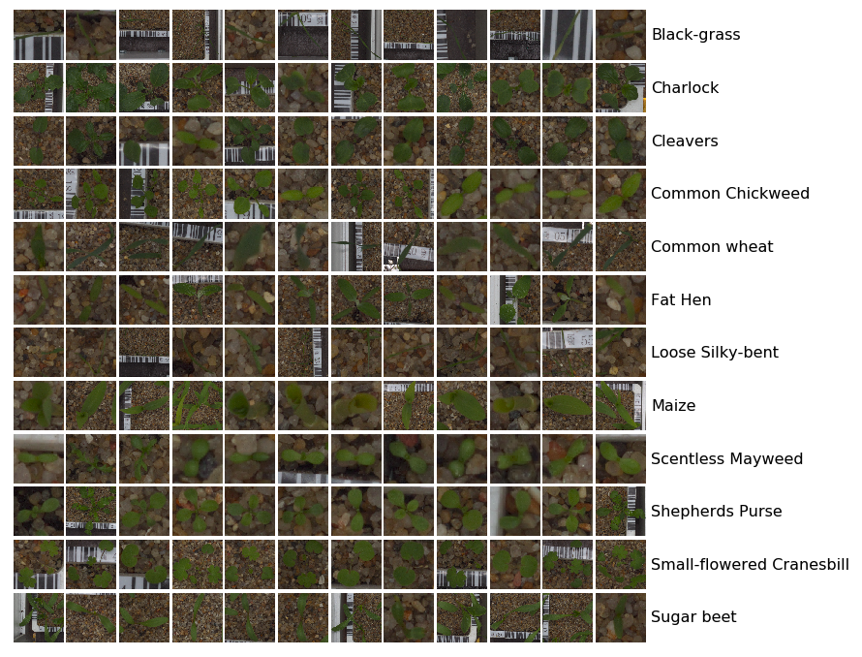
Dataset Observations
INTRODUCTION
Varying image resolutions
Sizes varies from 154x154 to 1285x1285 pixels
Coloured images
Taken in different lighting
Similar background of soil
High similarity between classes
Leaves of different species looks alike
Notes:
Some of the observations made on the dataset are
Varying image resolutions. Image size varies from 154 by 154 to 1285 by 1285 pixels
Coloured images taken in different lightning and have similar backgrounds
some species looks very alike to one another
We will discuss the steps taken to tackle these observations in the data preprocessing

Slide 6

Data Preprocessing
DATA PREPARATION
Data Augmentation
Resizing and Flattening
Coloured Data
Notes:
For data preparation, we have taken 3 steps to preprocess the data, which are data augmentation, resizing and flatten and some steps for the coloured data specifically.

Slide 7
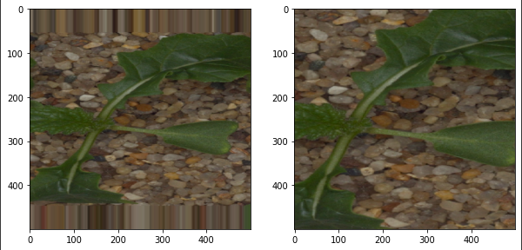
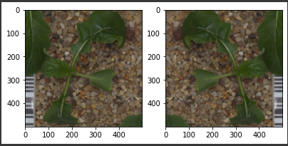
Data Augmentation
DATA PREPARATION
To increase the variation of the dataset, data augmentation has been used to enhance the images.
Zoom
Horizontal Flip
Notes:
Data augmentation has been done to help increase the variation of the dataset. Some of the augmentation we used were zoom and horizontal flip. By increasing the variation, it helps to improve the performance and reduce generalisation error for the model.

Slide 8
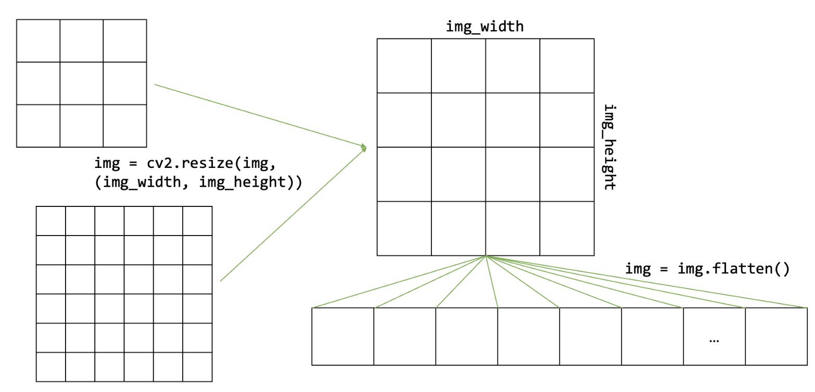
2. Resizing and Flattening
DATA PREPARATION
Observation: Varying image resolutions
All the images have been resized to a fixed size using the function
Images have been flattened for models that only read 1-dimensional arrays
Notes:
As previously discussed, the dataset consists of images of varying resolution. Hence, we have used cv2.resize to help resize all images to a fixed size. Additionally, for models that only read 1-dimensional arrays, it is also flattened.

Slide 9
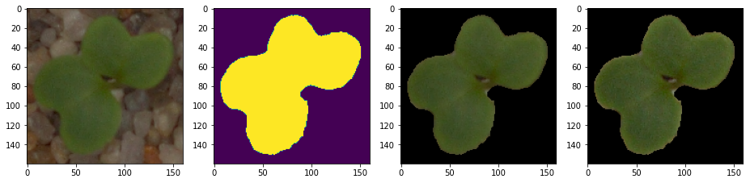
3. Coloured Data
DATA PREPARATION
Original image
Converted to HSV (hue-saturation-value) to create a mask
The mask is then applied to the images
Image is sharpened
Notes:
To preprocess the coloured images, we have performed the following steps.
First, we converted the image to HSV to help create a mask, this is to extract the green pixels from the image, which is the domain knowledge.
Then we applied the mask to the images.
Lastly, the images were sharpened to help the features stand out even better.

Slide 10
Feature Engineering
DATA PREPARATION
Notes:
Feature engineering refers to the process of using domain knowledge to select and transform the most relevant variables from raw data when creating a predictive model using machine learning or statistical modelling.
Hence the first step taken is as previously mentioned, to extract only the green pixels from the images. This helps to reduce any noise factors that might confuse the model.
The second step we took was to use a transfer learning model, Xception to identify the parts of the original image that is a seedling and return the extracted features in numbers for inputs to model training.
= a model is trained on a large and general enough dataset, this model will effectively serve as a generic model of the visual world.
You can then take advantage of these learned feature maps without having to start from scratch by training a large model on a large dataset.
Feature Extraction: Use the representations learned by a previous network to extract meaningful features from new samples. You simply add a new classifier, which will be trained from scratch, on top of the pretrained model so that you can repurpose the feature maps learned previously for the dataset.

Slide 11
Feature Engineering
DATA PREPARATION
Extracting Green Pixels, leaves of seedlings
Notes:
Feature engineering refers to the process of using domain knowledge to select and transform the most relevant variables from raw data when creating a predictive model using machine learning or statistical modelling.
Hence the first step taken is as previously mentioned, to extract only the green pixels from the images. This helps to reduce any noise factors that might confuse the model.
The second step we took was to use a transfer learning model, Xception to identify the parts of the original image that is a seedling and return the extracted features in numbers for inputs to model training.
= a model is trained on a large and general enough dataset, this model will effectively serve as a generic model of the visual world.
You can then take advantage of these learned feature maps without having to start from scratch by training a large model on a large dataset.
Feature Extraction: Use the representations learned by a previous network to extract meaningful features from new samples. You simply add a new classifier, which will be trained from scratch, on top of the pretrained model so that you can repurpose the feature maps learned previously for the dataset.

Slide 12
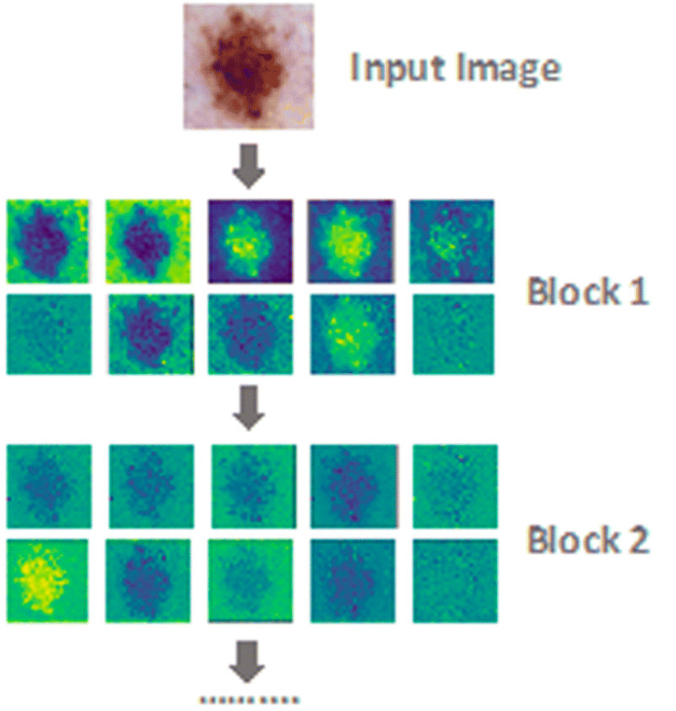
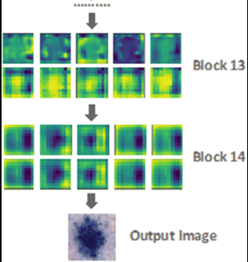
Feature Engineering
DATA PREPARATION
Extracting Green Pixels, leaves of seedlings
Transfer Learning, Xception
Notes:
Feature engineering refers to the process of using domain knowledge to select and transform the most relevant variables from raw data when creating a predictive model using machine learning or statistical modelling.
Hence the first step taken is as previously mentioned, to extract only the green pixels from the images. This helps to reduce any noise factors that might confuse the model.
The second step we took was to use a transfer learning model, Xception to identify the parts of the original image that is a seedling and return the extracted features in numbers for inputs to model training.
= a model is trained on a large and general enough dataset, this model will effectively serve as a generic model of the visual world.
You can then take advantage of these learned feature maps without having to start from scratch by training a large model on a large dataset.
Feature Extraction: Use the representations learned by a previous network to extract meaningful features from new samples. You simply add a new classifier, which will be trained from scratch, on top of the pretrained model so that you can repurpose the feature maps learned previously for the dataset.

Slide 13
Methodology & Experiments
Notes:
Now let’s move on to the methodology and experiments.

Slide 14
Random Forest Classifier
EXPERIMENTS
Raw Model, Hyperparameters Tuning and Feature Engineering
Notes:
Starting with the random forest classifier, we will be looking at the raw classifier model, followed by our attempt at hyperparameters tuning, and finally feature engineering.

Slide 15
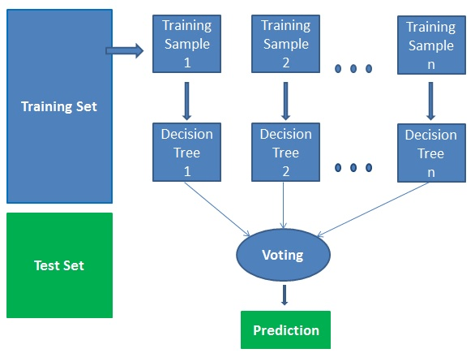
Random Forest Classifier
Ensemble of decision trees
Merged based on voting
Resistance to overfitting
Bias cancellation
Experiment:
Train-Validation Split (80-20):
Train: 3800
Validation: 950
Number of trees in the forest:
500
Kaggle F-score:
RFC: 0.67128
Notes:
The "random forest" refers to an ensemble of decision trees, which are then merged based on voting to improve the overall result. An advantage of RFC is its resistance to overfitting since it averages the prediction, which cancels out biases. We will be using an 80-20 train-validation for this and the following 4 models. Setting the number of trees in the forest to 500, we obtained a test accuracy of about 67%.

Slide 16
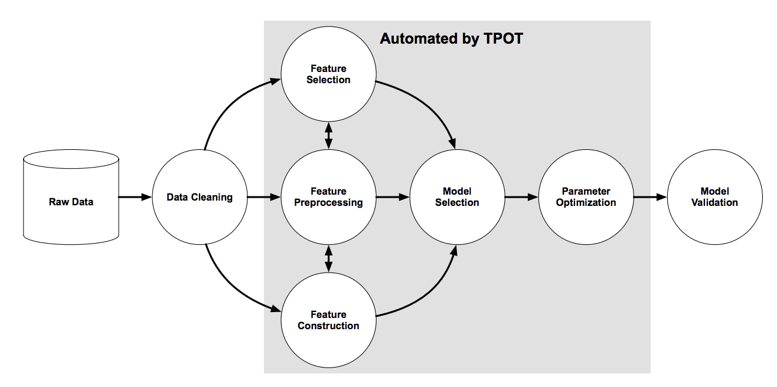
Hyperparameters Tuning -
TPOT Library
Automated Machine Learning
Optimises learning pipeline
Genetic programming
Notes:
We have looked into hyperparameters tuning, with the use of the TPOT Library. TPOT is a Python Automated Machine Learning tool that optimizes machine learning pipelines using genetic programming.

Slide 17
RFC + Hyperparameters Tuning
Hyperparamter | Value
n_estimator | 1600
max_features | sqrt
max_depth | 670
min_samples_split | 5
min_sample_leaf | 1
criterion | gini
generations | 5
population_size | 24
offspring_size | 12
verbosity | 2
early_stop | 12
cv | 4
TPOT Classifier
Returns the best hyperparameters found
Experiment:
Train-Validation Split:
Train: 3800
Validation: 950
Kaggle F-score:
RFC: 0.67128
RFC + Tuning: 0.69395
Notes:
After applying TPOT to the random forest model, this table shows the best hyperparameters found. However, the test accuracy score of about 69% was not significantly better than the raw classifier model. Due to the large processing time required for little improvement, subsequent models were not tuned with TPOT.

Slide 18
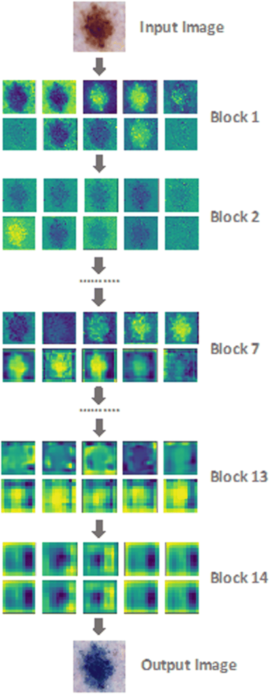
RFC + Feature Engineering
Feature Extraction
Xception Transfer Learning Model
Output extracted features used to train RFC
Experiment:
Train-Validation Split:
Train: 3800
Validation: 950
Number of trees in the forest:
500
Kaggle F-score:
RFC: 0.67128
RFC + Tuning: 0.69395
RFC + Xception: 0.85894
Notes:
Next, we used the output extracted features from Xception transfer learning model to train the classifier. Using the same hyperparameter as the raw model, there was a much larger improvement in the test accuracy to about 86%.

Slide 19
Support Vector Machine
EXPERIMENTS
Linear SVM
Raw Model & Feature Engineering
Notes:
Moving on to the support vector machine, which we used the linear kernel for our experiments.

Slide 20
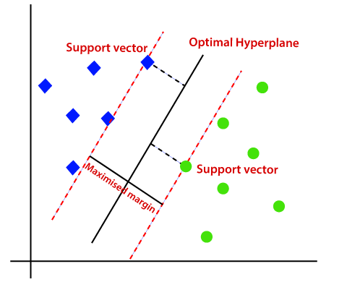
Support Vector Machine
Linear SVM
Decision boundary separates different classes
Capable of handling high dimensional data
Relatively memory efficient
Experiment:
Train-Validation Split:
Train: 3800
Validation: 950
Regularisation Parameter: 1
Decision Function Shape: ovo
Kaggle F-score:
SVM: 0.60327
Notes:
The linear SVM finds a decision boundary to separate different classes with a maximised margin. It is capable of handling high dimensional data while being relatively memory efficient. We managed to obtain a test accuracy score of about 60% for the raw model.

Slide 21
SVM + Feature Engineering
Feature Extraction
Xception Transfer Learning Model
Output extracted features used to train SVM
Experiment:
Train-Validation Split:
Train: 3800
Validation: 950
Regularisation Parameter: 1
Decision Function Shape: ovo
Kaggle F-score:
SVM: 0.60327
SVM + Xception: 0.89420
Notes:
Likewise, we used the output features from Xception and obtained a decent accuracy of about 89%, which is a significant improvement from the raw model.

Slide 22
K-Nearest Neighbours
EXPERIMENTS
Raw Model & Feature Engineering
Notes:
The third model we tried is the K-Nearest Neighbours classifier, which is commonly used for classification problems.

Slide 23
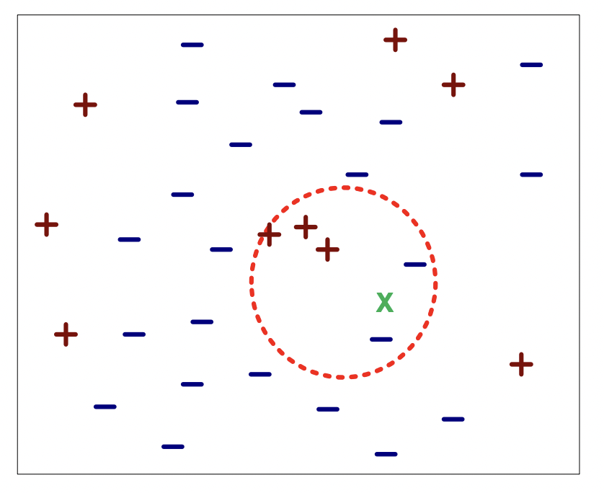
K-Nearest Neighbours
Commonly used for classification
Finds K-nearest neighbours using Euclidean distance
Majority vote of class labels among the K-nearest neighbours
Experiment:
Train-Validation Split:
Train: 3800
Validation: 950
‘K’ value / Number of neighbours: 15
Kaggle F-score:
KNN: 0.36964
Notes:
K nearest neighbours is a rather straightforward algorithm, which takes the majority vote of class labels among the k nearest neighbours. For this experiment, it finds the 15 nearest neighbours, but has a poor accuracy score of about 37%.

Slide 24
KNN + Feature Engineering
Feature Extraction
Xception Transfer Learning Model
Output extracted features used to train KNN
Experiment:
Train-Validation Split:
Train: 3800
Validation: 950
‘K’ value / Number of neighbours: 15
Kaggle F-score:
KNN: 0.36964
KNN + Xception: 0.83627
Notes:
However, when taking feature inputs from the Xception model, the accuracy jumped significantly to about 84%.

Slide 25
Deep Neural Network
EXPERIMENTS
Raw Model & Feature Engineering
Notes:
Let’s move on to the deep neural network.

Slide 26
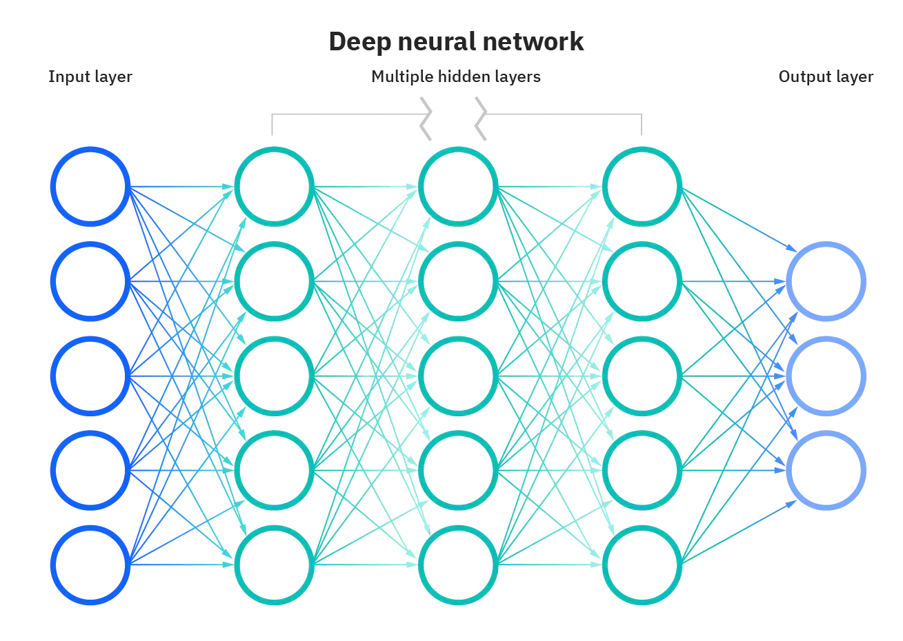
Deep Neural Network
Neural Network consisting of more than three layers
Strong ability to learn the abstract representations of any input data
Cluster inputs effectively
Experiment:
Fully-Connected Neural Network
Train-Validation Split:
Train: 3800
Validation: 950
Nadam optimiser
Learning Rate: 0.0004
Beta 1: 0.9
Beta 2: 0.999
Number of Epochs: 50
Early Stopping
Kaggle F-score:
DNN: 0.34508
Notes:
Which has a strong ability to learn the abstract representations of any input data. By observing patterns in the data, it can cluster inputs effectively. However, the raw model performed poorly with an accuracy score of about 34.5%.

Slide 27
DNN + Feature Engineering
Feature Extraction
Xception Transfer Learning Model
Output extracted features used to train DNN
Experiment:
Fully-Connected Neural Network
Train-Validation Split:
Train: 3800
Validation: 950
Nadam optimiser
Learning Rate: 0.0004
Beta 1: 0.9
Beta 2: 0.999
Number of Epochs: 50
Early Stopping
Kaggle F-score:
DNN: 0.34508
DNN + Xception: 0.90176
Notes:
When trained on the features from Xception, the test accuracy made a huge leap to about 90%, which is now one of the best performing models.

Slide 28
Convolutional Neural Network
EXPERIMENTS
Raw Model & Feature Engineering
Notes:
The fifth model we explored is the convolutional neural network, which is a class of Deep Neural Network.

Slide 29

Convolutional Neural Network
A class of DNN
Capture spatial dependencies in an image with relevant filters
Reduce number of parameters involved
Reusing of weights
Experiment:
Train-Validation Split:
Train: 3800
Validation: 950
Number of neurons in i^{th} hidden layer
Layer 1: 300
Layer 2: 200
Maximum number of iterations: 1000
Kaggle F-score:
CNN: 0.62090
Notes:
It is able to capture spatial dependencies in an image with relevant filters. It is also able to reduce the number of parameters involved and reuse weights, making it better fitting to the image dataset. The raw model achieves an accuracy score of about 62%.

Slide 30
CNN + Feature Engineering
Feature Extraction
Xception Transfer Learning Model
Output extracted features used to train CNN
Experiment:
Train-Validation Split:
Train: 3800
Validation: 950
Number of neurons in i^{th} hidden layer
Layer 1: 300
Layer 2: 200
Maximum number of iterations: 1000
Kaggle F-score:
CNN: 0.62090
CNN + Xception: 0.90428
Notes:
With the help of Xception, the CNN model now performs rather well with an accuracy score of about 90%.

Slide 31
Efficient Net
EXPERIMENTS
Transfer Learning Model 3

Slide 32
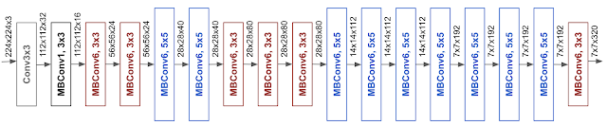
Efficient Net
Transfer Learning Model
CNN and scaling method
AutoML and compound scaling
Experiment:
Train-Validation Split:
Train: 4279
Validation: 471
Number of layer_{i} and activation function:
Layer₁: 1024, reLu
Layer₂: 12, softmax
Number of Epochs: 100
Optimiser:
Adam (LR = 0.0005)
CallBacks:
EarlyStopping
ReduceLROnPlateau
ModelCheckPoint
Kaggle F-score:
EfficientNet: 0.97103
Notes:
EfficientNet is a CNN and scaling method that uniformly scales all dimensions of depth/width/resolution using a compound coefficient. It is among the most efficient models that reaches State-of-the-Art accuracy on both imagenet and common image classification transfer learning tasks. It relies on AutoML and compound scaling to achieve superior performance without compromising resource efficiency.
The efficientnet pre train model was used as a base model which is followed by 2 layers consisting of a hidden layer and a output layer. The hidden layer has 1024 units with ReLu activation function and the output layer has 12 units with softmax activation function.
After training, the model was able to achieve a F-score of 97.1%

Slide 33
Xception
EXPERIMENTS
Transfer Learning Model 1

Slide 34
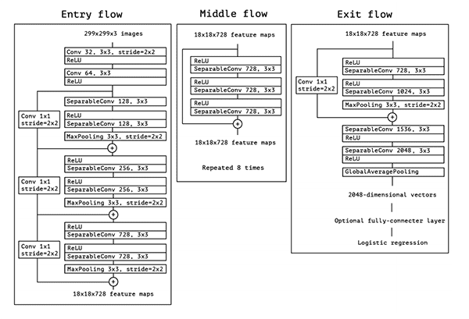
Xception
Transfer Learning Model
Extension of Inception Architecture
Experiment:
Train-Validation Split:
Train: 4279
Validation: 471
Number of layer_{i} and activation function:
Layer₁: 1024, reLu
Layer₂: 12, softmax
Number of Epochs: 100
Optimiser:
Adam (LR = 0.0005)
CallBacks:
EarlyStopping
ReduceLROnPlateau
ModelCheckPoint
Kaggle F-score:
Xception: 0.97984
Notes:
The xception, which stands for extreme version of inception, is a pre-trained model which was trained on more than a million images from the ImageNet database and it is 71 layers deep.
This xception pre-trained model was used as a base model which is further followed by 2 additional layers, consisting of a hidden layer and a output layer. The hidden layer has 1024 units with ReLu activation function and the output layer has 12 units with softmax activation function.
After training, the model was able to achieve a F-score of 98%

Slide 35
Inception-ResNet-v2
EXPERIMENTS
Transfer Learning Model 2

Slide 36
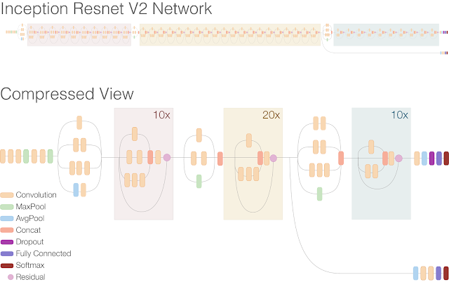
Inception-ResNet-v2
Transfer Learning Model
Combines ideas from Microsoft ResNet Paper with Inception v3 model
Experiment:
Train-Validation Split:
Train: 4279
Validation: 471
Number of layer_{i} and activation function:
Layer₁: 1024, reLu
Layer₂: 12, softmax
Number of Epochs: 100
Optimiser:
Adam (LR = 0.0005)
CallBacks:
EarlyStopping
ReduceLROnPlateau
ModelCheckPoint
Kaggle F-score:
Inception: 0.98110
Notes:
The inception pre-trained model was trained on more than a million images from the ImageNet database. The network is 164 layers deep and can classify images into 1000 object categories. Therefore, the network has learned rich feature representations for a wide range of images.
The inception pre trained model was used as a base model which is further followed by 2 additional layers, consisting of a hidden layer and a output layer. The hidden layer has 1024 units with ReLu activation function and the output layer has 12 units with softmax activation function.
After training, the model was able to achieve a F-score of 98.1%

Slide 37
Ensemble Learning
EXPERIMENTS
Xception, Inception & Efficient Net: Combined

Slide 38
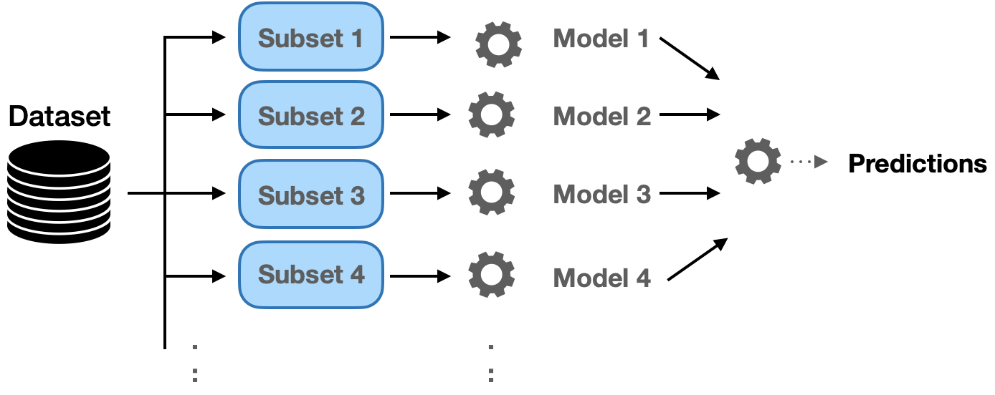
Ensemble Learning
Ensemble Xception, Inception & Efficient Net
Experiment:
Train-Validation Split:
Train: 4279
Validation: 471
Number of layer_{i} and activation function:
Layer₁: 10, reLu
Layer₂: 12, softmax
Number of Epochs: 100
Optimiser:
Adam (LR = 0.001)
CallBacks:
EarlyStopping
ReduceLROnPlateau
ModelCheckPoint
Kaggle F-score:
Inception: 0.97113
Notes:
Ensemble learning is a machine learning technique to combine multiple models, also known as base estimators, in the prediction process. Overall, it is able to overcome the challenges of high variance, low accuracy and features noise and bias which might occur when using a single model. Since all models have their own limitations, by aggregating them, the overall accuracy could get boosted. Some popular ensemble learning techniques include max voting, weighted average, bagging, boosting, stacking and blending.
Ensemble learning is performed by concatenating the outputs of the three pre-trained models into a single concatenation layer. This is followed by a hidden layer of 10 units using a relu activation function and the output layer of 12 units using softmax activation function.
After training, the model was able to achieve a F-score of 97.1%

Slide 39

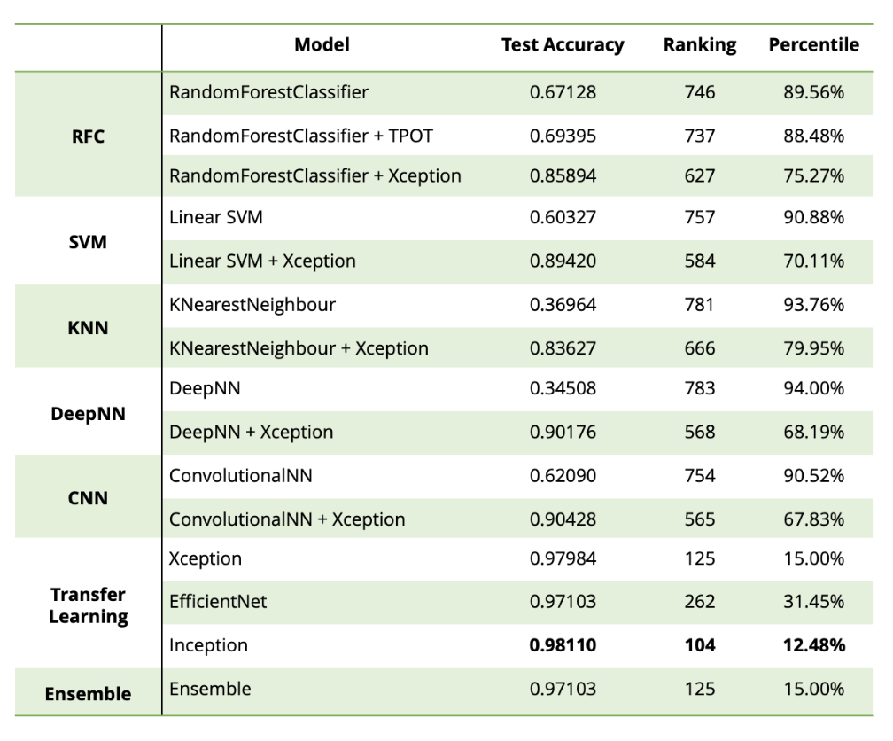
Final Results
CONCLUSION
Notes:
To conclude our project, here are our final results. We can observe that the transfer learning and ensemble learning models achieved a much higher score as compared to the rest of the models. The model which achieved the highest accuracy is the pre-trained inception model which was fine tuned on our dataset. It was able to get a test acc of 0.98110, and it was ranked 104 in the leaderboard which is the top 12.48%.

Slide 40
Solution Novelty
Transfer Learning
Xception, InceptionV2, and EffiicientNetB2
Trained on large dataset
Require fine tuning
Dropout
Reduce overfitting
Improves generalisation
Keras CallBack
ReduceLROnPlateau
EarlyStopping
Saving best model
Last training epoch not necessary the best
Test data augmentation
Creates multiple augmented copies of each image in the test set
CONCLUSION
Notes:
Several novel techniques were implemented to improve on the model performance.
Firstly we used pretrained models that have been trained on a large dataset. After fine tuning the model, we were able to leverage on the parameters to improve the performance.
Secondly, to ensure the model does not overfit and generalises well, we have introduced dropout layers
Thirdly, we have used two keras callback namely ReduceLROnPlateau and earlystopping. ReduceLROnPlateau reduces the learning rate by a predefined factor whenever the validation accuracy is stagnant, which improves the chance of finding the global minimal during gradient descent. As for earlystopping, it stops the training when the validation accuracy stops increasing.
Fourthly, we save the model with the best val acc as we have noticed that the last training epoch does not provide the model with the best val accuracy
Lastly, test-time augmentation creates multiple augmented copies of each image in the test set, then aggregates the predictions across all transformed version of the test input, which helps to increase the accuracy

Slide 41
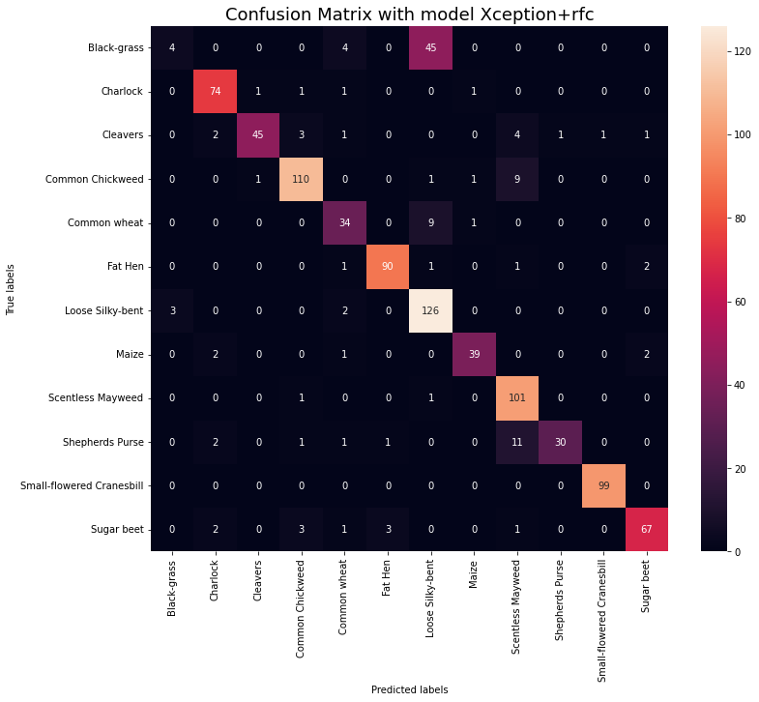
Challenges Faced
CONCLUSION
Misclassification for specific classes
Time and Resources Constraint
Limited memory/Hardware constraints
Fine-tuning of hyperparameters
Unexpected Performance of Ensemble Model
Notes:
Some of the challenges faced in this project are:
Misclassification of specific classes. To evaluate our model, we plotted the confusion matrix of our results and 2 particular species are commonly misclassified, which are black-grass and loose silky-bent. This could be one of the main hurdles to achieving a higher accuracy

Slide 42
Challenges Faced
CONCLUSION
Misclassification for specific classes
Time and Resources Constraint
Limited memory/Hardware constraints
Fine-tuning of hyperparameters
Unexpected Performance of Ensemble Model
Notes:
We faced time and resources constraint. With a large dataset and heavy preprocessing, the time taken to run and train some models takes up several hours and even days, even with GPU processing. This heavily restricted us on the number of experiments we could conduct within the short period of this project.

Slide 43
Challenges Faced
CONCLUSION
Misclassification for specific classes
Time and Resources Constraint
Limited memory/Hardware constraints
Fine-tuning of hyperparameters
Unexpected Performance of Ensemble Model
Notes:
The limited memory we have on our hardware. Which restricted us from increase the resolution of the images for processing which could have potentially given better prediction accuracies.

Slide 44
Challenges Faced
CONCLUSION
Misclassification for specific classes
Time and Resources Constraint
Limited memory/Hardware constraints
Fine-tuning of hyperparameters
Unexpected Performance of Ensemble Model
Notes:
Despite the attempt of using TPOT to help finetune the RFC parameters, the result achieved did not reflect any improvement. Overall, finetuning of models requires trial and error, which is time-consuming.

Slide 45
Challenges Faced
CONCLUSION
Misclassification for specific classes
Time and Resources Constraint
Limited memory/Hardware constraints
Fine-tuning of hyperparameters
Unexpected Performance of Ensemble Model
Notes:
Ensemble methods use multiple learning algorithms to obtain better predictive performance than could be obtained from any of the constituent learning algorithms alone. However, that was not the case for our attempt. Some of the reasons we have thought of includes dimensionality explosion and substantial bias in the train and validation sets.

Slide 46

Lesson Learnt
CONCLUSION
Notes:
Complete Machine Learning Workflow
The team has gained insights on the entire machine learning workflow, from data pre-processing, building datasets, model training, refinement to evaluation.
Explored Various Models
We explored an array of machine learning models and It was an eye opener to know how machine learning has grew and developed over the years.
Importance of Feature Engineering
With the use of feature engineering, the team was able to achieve an improvement of 55.668%. This allowed us to learn about the benefits of feature engineering.
Soft Skills
We have practised soft skills which includes project management, documentations and teamwork. As a team, we respected one another’s opinion and often provided updates to ensure a steady progression of the team.

Slide 47
Lesson Learnt
1
2
Complete Machine
Learning Workflow
Explored
Various Models
3
4
Importance of
Feature Engineering
Soft Skills
CONCLUSION
Notes:
Complete Machine Learning Workflow
The team has gained insights on the entire machine learning workflow, from data pre-processing, building datasets, model training, refinement to evaluation.
Explored Various Models
We explored an array of machine learning models and It was an eye opener to know how machine learning has grew and developed over the years.
Importance of Feature Engineering
With the use of feature engineering, the team was able to achieve an improvement of 55.668%. This allowed us to learn about the benefits of feature engineering.
Soft Skills
We have practised soft skills which includes project management, documentations and teamwork. As a team, we respected one another’s opinion and often provided updates to ensure a steady progression of the team.

Slide 48
Lesson Learnt
1
2
Complete Machine
Learning Workflow
Explored
Various Models
3
4
Importance of
Feature Engineering
Soft Skills
CONCLUSION
Notes:
Complete Machine Learning Workflow
The team has gained insights on the entire machine learning workflow, from data pre-processing, building datasets, model training, refinement to evaluation.
Explored Various Models
We explored an array of machine learning models and It was an eye opener to know how machine learning has grew and developed over the years.
Importance of Feature Engineering
With the use of feature engineering, the team was able to achieve an improvement of 55.668%. This allowed us to learn about the benefits of feature engineering.
Soft Skills
We have practised soft skills which includes project management, documentations and teamwork. As a team, we respected one another’s opinion and often provided updates to ensure a steady progression of the team.

Slide 49
Lesson Learnt
1
2
Complete Machine
Learning Workflow
Explored
Various Models
3
4
Importance of
Feature Engineering
Soft Skills
CONCLUSION
Notes:
Complete Machine Learning Workflow
The team has gained insights on the entire machine learning workflow, from data pre-processing, building datasets, model training, refinement to evaluation.
Explored Various Models
We explored an array of machine learning models and It was an eye opener to know how machine learning has grew and developed over the years.
Importance of Feature Engineering
With the use of feature engineering, the team was able to achieve an improvement of 55.668%. This allowed us to learn about the benefits of feature engineering.
Soft Skills
We have practised soft skills which includes project management, documentations and teamwork. As a team, we respected one another’s opinion and often provided updates to ensure a steady progression of the team.

Slide 50
Lesson Learnt
1
2
Complete Machine
Learning Workflow
Explored
Various Models
3
4
Importance of
Feature Engineering
Soft Skills
CONCLUSION
Notes:
Complete Machine Learning Workflow
The team has gained insights on the entire machine learning workflow, from data pre-processing, building datasets, model training, refinement to evaluation.
Explored Various Models
We explored an array of machine learning models and It was an eye opener to know how machine learning has grew and developed over the years.
Importance of Feature Engineering
With the use of feature engineering, the team was able to achieve an improvement of 55.668%. This allowed us to learn about the benefits of feature engineering.
Soft Skills
We have practised soft skills which includes project management, documentations and teamwork. As a team, we respected one another’s opinion and often provided updates to ensure a steady progression of the team.

Slide 51

Thank You

Slide 53

Methodologies
EXPERIMENTS
Hyperparameters Tuning
TPOT
Basic Machine Learning Models
Random Forest Classifier
Linear SVM
K Nearest Neighbour
Deep Neural Network
Convolutional Neural Network
3. Transfer Learning Model
Xception
Inception
EfficientNet
4. Ensemble Model

Slide 54
ignore after

Slide 55
Contents of this template
Here’s what you’ll find in this Slidesgo template:
A slide structure based on a Pitch Deck presentation, which you can easily adapt to your needs. For more info on how to edit the template, please visit Slidesgo School or read our FAQs.
An assortment of graphic resources that are suitable for use in the presentation can be found in the alternative resources slide.
A thanks slide, which you must keep so that proper credits for our design are given.
A resources slide, where you’ll find links to all the elements used in the template.
Instructions for use.
Final slides with:
The fonts and colors used in the template.
A selection of illustrations. You can also customize and animate them as you wish with the online editor. Visit Storyset to find more.
More infographic resources, whose size and color can be edited.
Sets of customizable icons of the following themes: general, business, avatar, creative process, education, help & support, medical, nature, performing arts, SEO & marketing, and teamwork.
You can delete this slide when you’re done editing the presentation.
Microclimate
Energy

Slide 56
Table of contents
01
02
Problem vs. solution
Product
03
04
Market & competition
Business model
You can describe the topic of the section here
You can describe the topic of the section here
You can describe the topic of the section here
You can describe the topic of the section here

Slide 57
—Someone Famous
Ecological
Organic
“This is a quote. Words full of wisdom that someone important said and can make the reader get inspired.”

Slide 58
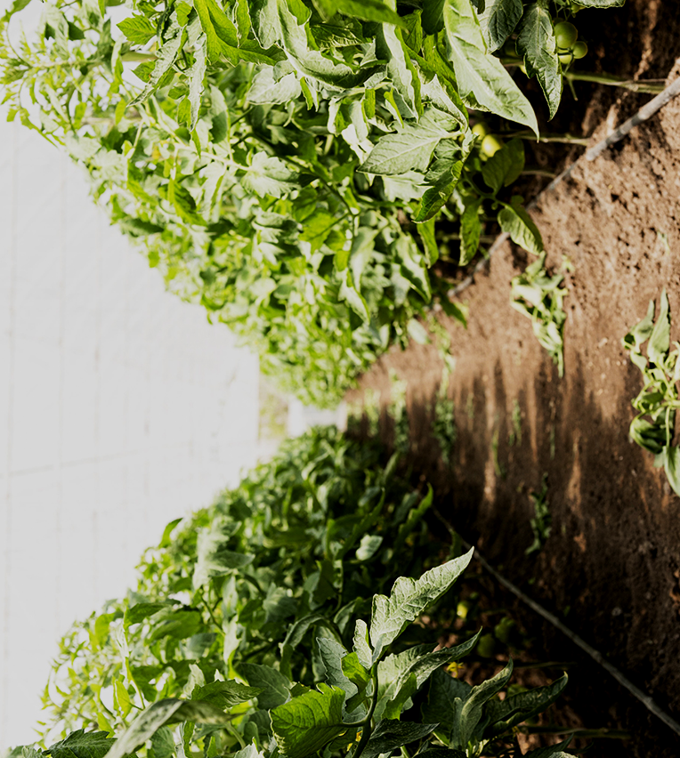
Introduction
Pitch Deck
You can give a brief description of the topic you want to talk about here. For example, if you want to talk about Mercury, you can say that it’s the smallest planet in the entire Solar System
Greenhouse

Slide 59

Our company
Ecosystem
Mercury is the closest planet to the Sun and the smallest one in the Solar System—it’s only a bit larger than the Moon. The planet’s name has nothing to do with the liquid metal since it was named after the Roman messenger god, Mercuryç
Climate

Slide 60


Our team
Elena James
Alexa Doe
Microclimate
Energy
You can replace the image on the screen with your own
You can replace the image on the screen with your own

Slide 61

01
Problem vs. solution
Ecological
Organic
You can enter a subtitle here if you need it

Slide 62
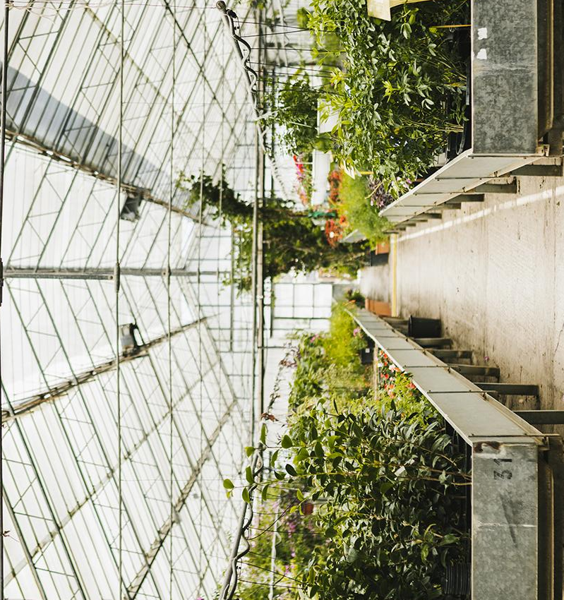
Problem
Pitch Deck
Do you know what helps you make your point clear? Lists like this one:
Because they’re simple
You can organize your ideas clearly
And because you’ll never forget to buy milk!
And the most important thing: the audience won’t miss the point of your presentation
Greenhouse

Slide 63


Them
Us
Ecosystem
Mercury is the closest planet to the Sun and the smallest one. It’s only a bit larger than the Moon
Venus has a beautiful name and is the second planet from the Sun. It’s terribly hot, even hotter than Mercury
Climate

Slide 64

Solution
Energy
Microclimate
Venus has a beautiful name and is the second planet from the Sun. It’s terribly hot

Slide 65
SWOT analysis
Strengths
Opportunities
S
O
Weaknesses
Threats
W
T
Ecological
Organic
Mercury is the closest planet to the Sun
Jupiter is the biggest planet of them all
Saturn is composed of hydrogen and helium
Despite being red, Mars is very cold

Slide 66

Product demo
Microclimate
Energy
You can change the image on the screen with your own work. Just delete this one, add yours and center it

Slide 67

Product overview
Mercury
Venus
It’s the closest planet to the Sun and the smallest one in the Solar System
Venus has a beautiful name and is the second planet from the Sun

Slide 68
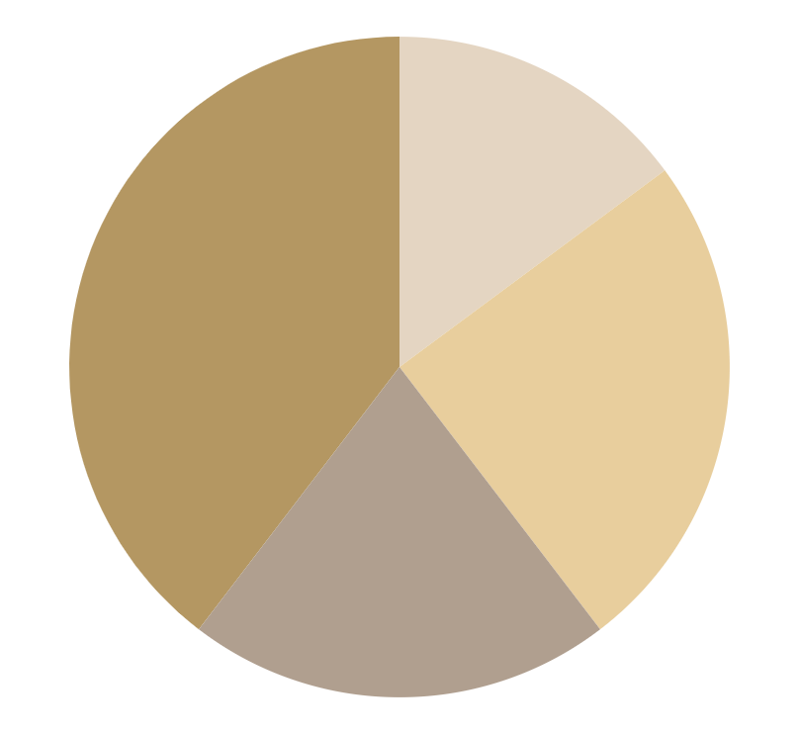
Traction
Ecosystem
$150,000
Gross revenue in 2021
Saturn
40K
Mars
20K
Saturn is a gas giant and has several rings
Despite being red, Mars is a very cold place
Mercury
25K
Venus
15K
It’s the smallest planet in the Solar System
Venus is the second planet from the Sun
Climate
Follow the link in the graph to modify its data and then paste the new one here. For more info, click here

Slide 69
Our plans
 | Basic | Pro | Premium
Weight | 1 Kg | 5 Kg | 10 Kg
Period | 1 month | 6 months | 1 year
Prices | $10 | $25 | $50
Microclimate
Energy

Slide 70
Investments
Jupiter
Saturn
Neptune
It’s composed of hydrogen and helium
It’s the farthest planet from the Sun
Mercury
Mercury is the closest planet to the Sun
It’s the biggest planet of them all

Slide 71
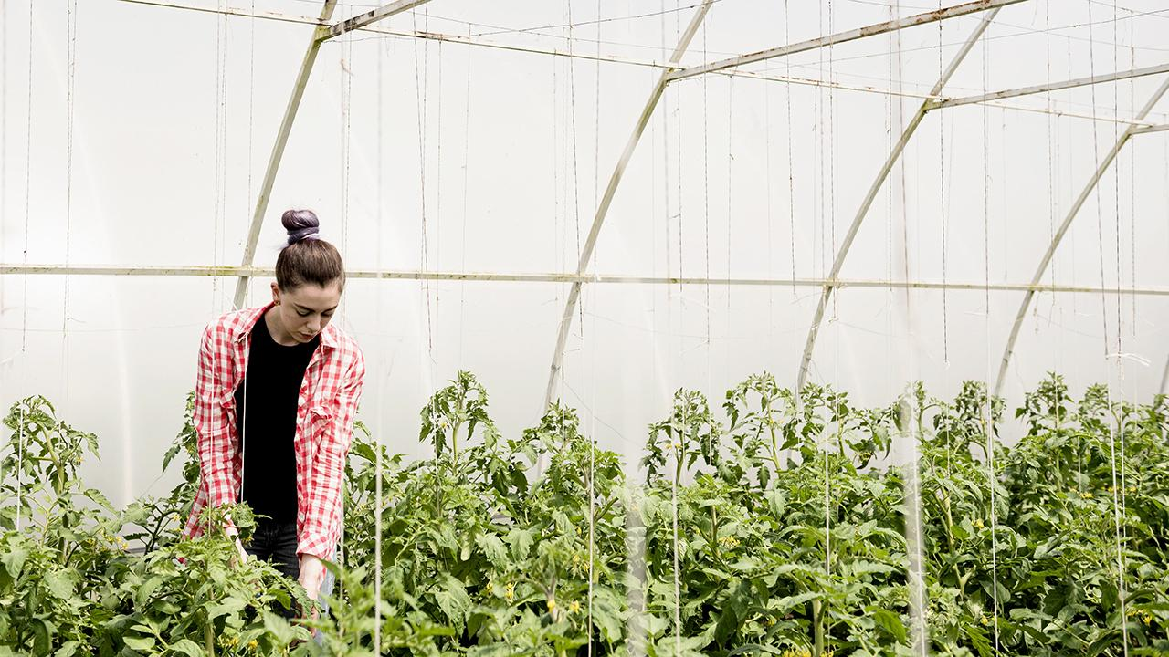
A picture is worth a thousand words

Slide 72
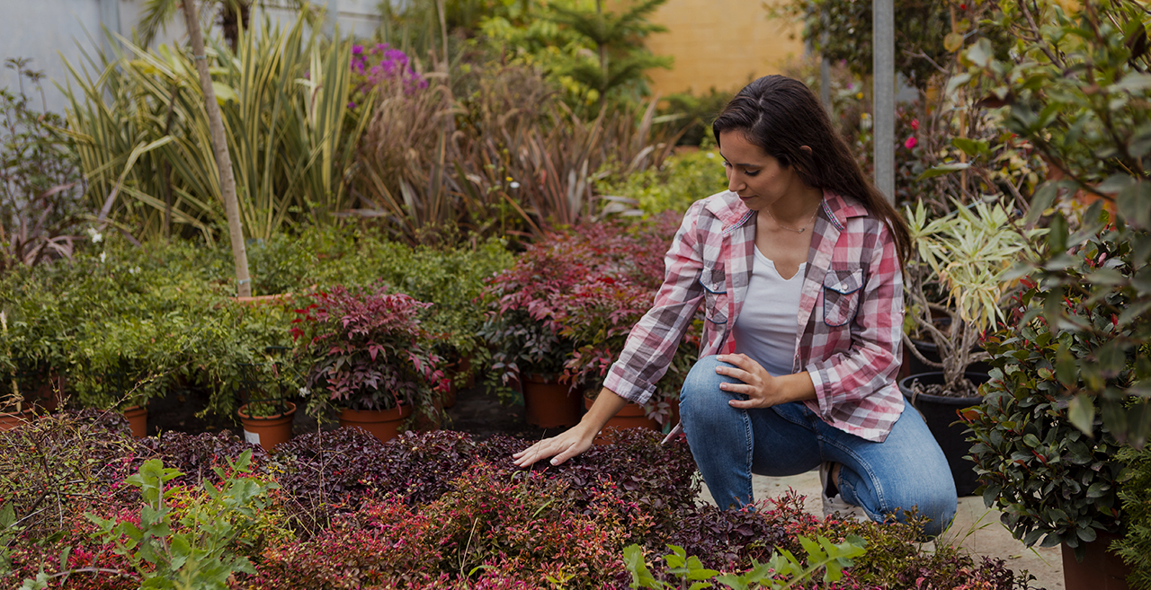
10,000,000
Big numbers catch your audience’s attention
Microclimate
Energy

Slide 73

Competitors
Mars
Saturn
Venus
Jupiter
Ecological
Organic
Despite being red, Mars is a cold place
Saturn is a gas giant and has several rings
Venus is the second planet from the Sun
It’s the biggest planet of them all

Slide 74
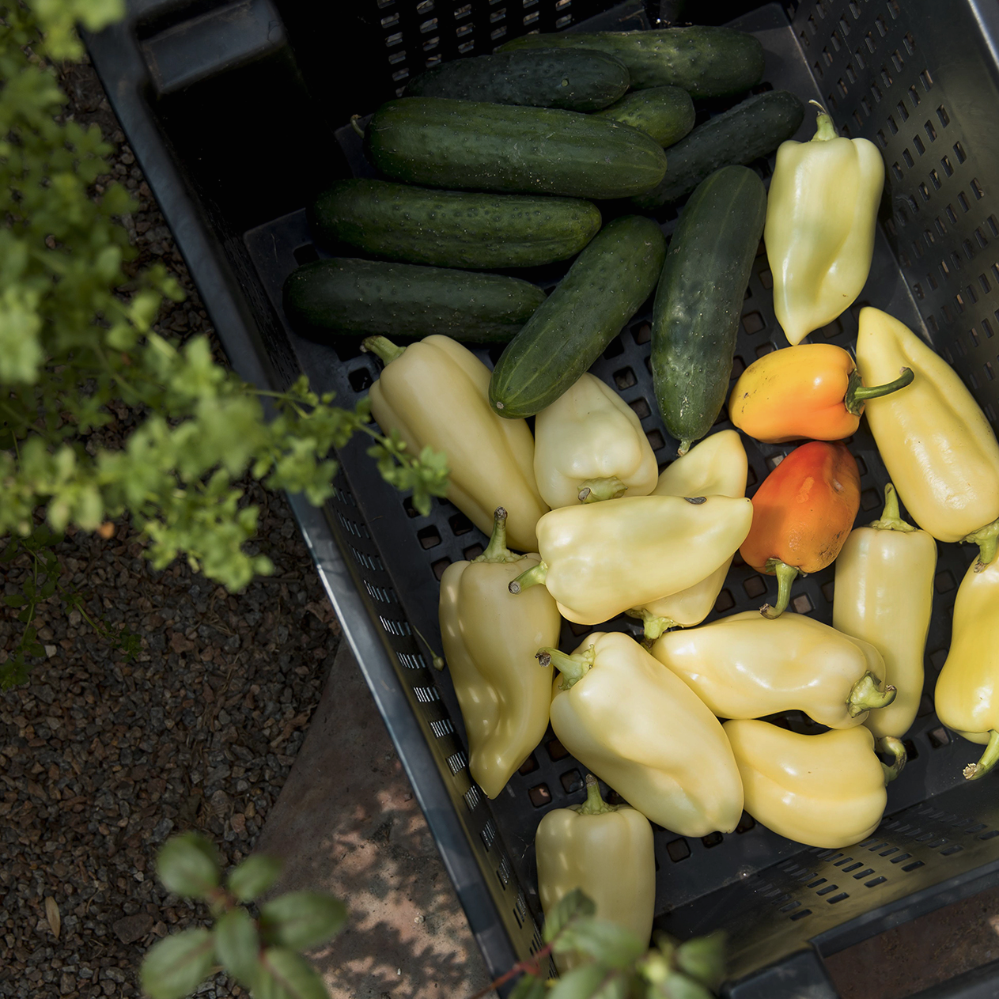
Reviews
Laura Patterson
Jenna Smith
John James
Pitch Deck
“Neptune is the farthest planet from the Sun and the fourth-largest object by diameter”
Greenhouse
“Mercury is the closest planet to the Sun and also the smallest one in the Solar System”
“Mars is a cold place. It’s full of iron oxide dust, which gives the planet its reddish cast”

Slide 75
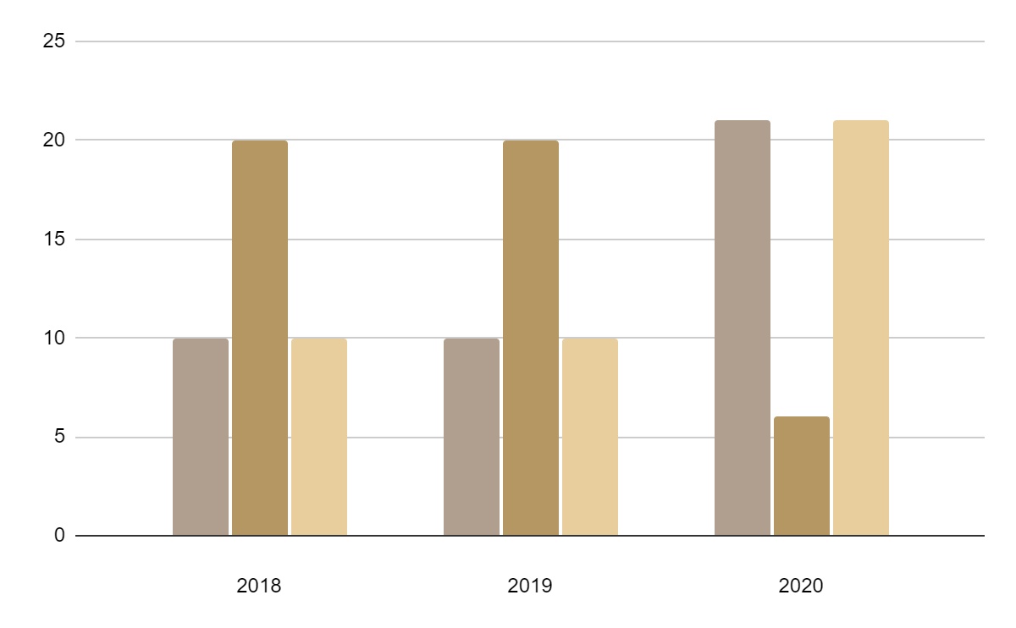
Predicted growth
Mars
Mars is actually a cold place. It’s full of iron oxide dust
Venus
Venus is the second planet from the Sun
Saturn
Saturn was named after the Roman god of wealth
Follow the link in the graph to modify its data and then paste the new one here. For more info, click here

Slide 76
Awesome words
Because key words are great for catching your audience’s attention

Slide 77
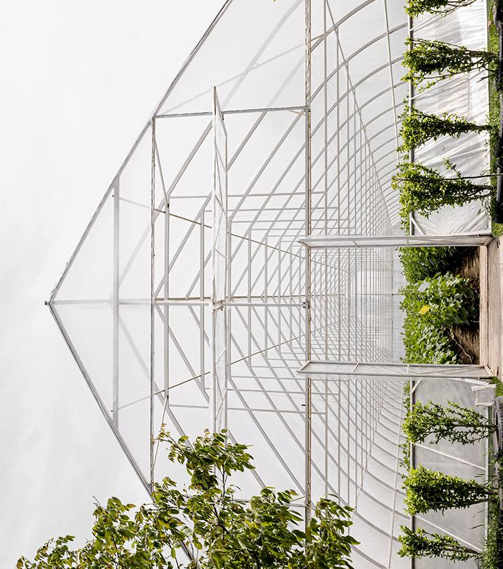
333,000
9h 55m 23s
386,000 km
Earths is the Sun’s mass
Is Jupiter’s rotation period
Distance between the Earth and the Moon

Slide 78

A picture always reinforces the concept
Ecosystem
Images reveal large amounts of data, so remember: use an image instead of long texts
Climate

Slide 79
Awards
Mercury
Venus
Mars
Jupiter
Saturn
Neptune
Ecological
Mercury is the closest planet to the Sun
Venus has a
beautiful name
Despite being red, Mars is a cold place
It’s the biggest planet in the Solar System
Saturn is the ringed planet and a gas giant
It’s the farthest planet from the Sun
Organic

Slide 80
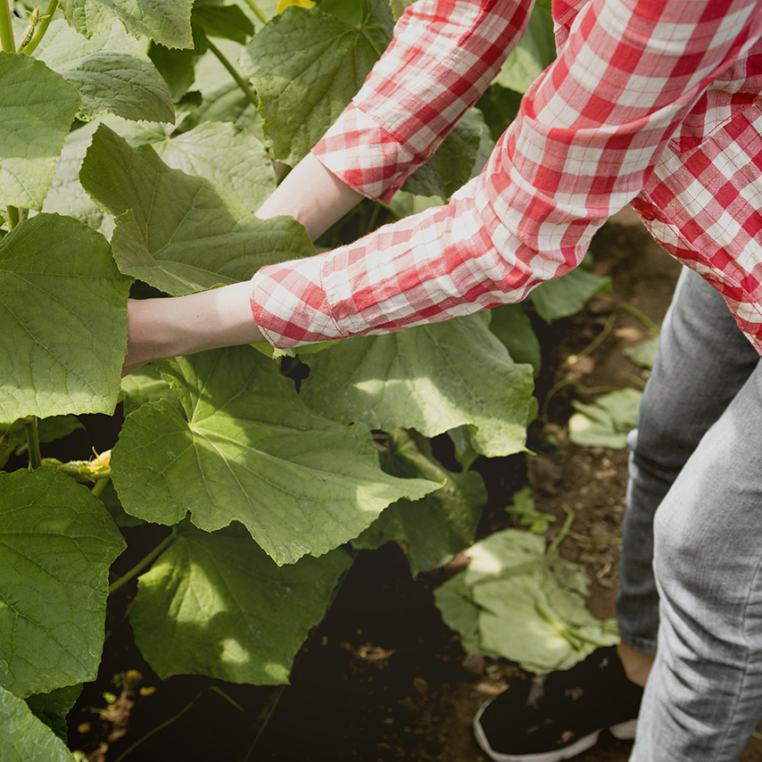
Business model
10K
20K
30K
Microclimate
Energy
Training
Neptune is the farthest planet from the Sun
Marketing
Saturn is composed of hydrogen and helium
Assessment
Mercury is the closest planet to the Sun

Slide 81
Case study
Challenge
Results
Solution
Despite being red, Mars is a cold place, not hot
Jupiter is the biggest planet of them all
Saturn is composed of hydrogen and helium

Slide 82
Target
Gender
Age
25 - 35
50%
36 - 45
25%
60%
40%
46 - 55
25%
Favorite product
8/10
9/10
9/10
10/10
Mercury is the smallest planet
Despite being red, Mars is a cold place
Venus has a
beautiful name
Neptune is far away from Earth

Slide 83
Alternative resources

